Slide 1
UART_SDRAM

Slide 2
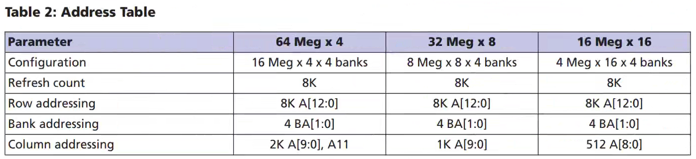
SDRAM
SDRAM, Synchronous Dynamic Radom Access, in this chapter we will introduce SDRAM briefly and using uart & sdram to build a project.
SDRAM is a memory can store a lot of data, and it’s feature like synchronous: working frequency is same as FPGA, dynamic: need to charge to make data wouldn’t lose, random: give the specific address and write or read the data in specific storage unit.
In this FPGA, use the 4 Meg x 16 x 4 bank sdram, means it have 4 bank, each bank have 4 mega storage unit, and 1 unit can store 16 bit width data.
Refer to below table, we also know the address of row is 8K, address of column is 512, if we want to read & write sdram, we need to using the bank address, row address and column address to find the correct storage position.

Slide 3
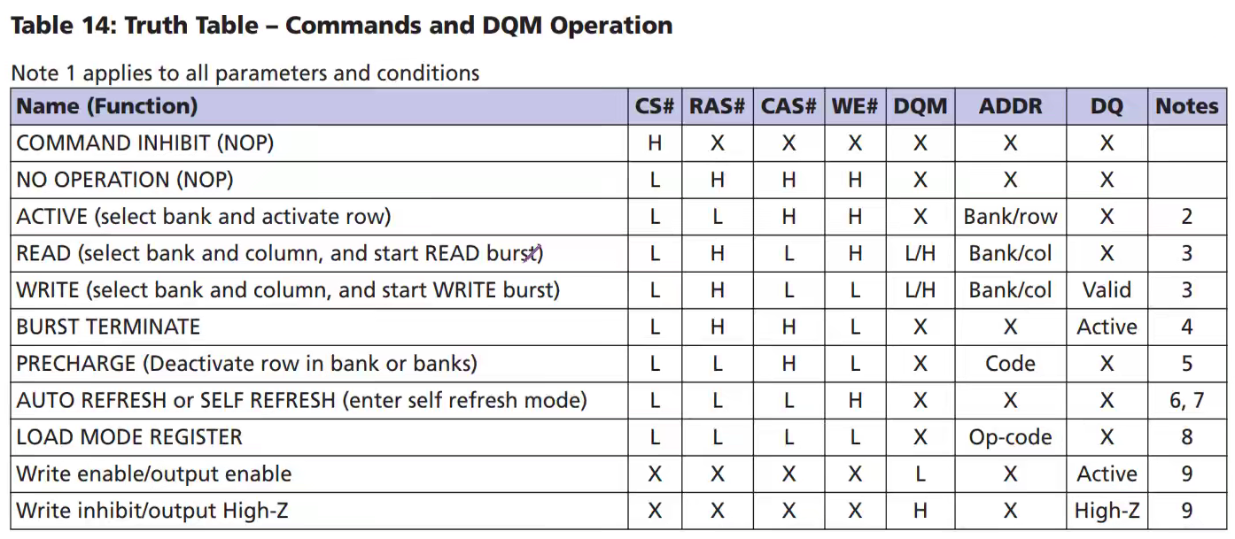
SDRAM_COMMAND
Refer to datasheet, we can find the sdram operating command as below table, detail please refer to datasheet.

Slide 4
Objective
Generate the sdram module and using rs232 to transfer 10 bytes data to FPGA and write to sdram. After written, read the data from sdram and transfer out by rs232.
In this objective, sdram using 100MHz working frequency, rs232 using 50MHz working frequency.
Due to sdram is complex, ohters parameter setting will introduce at each module section.

Slide 5
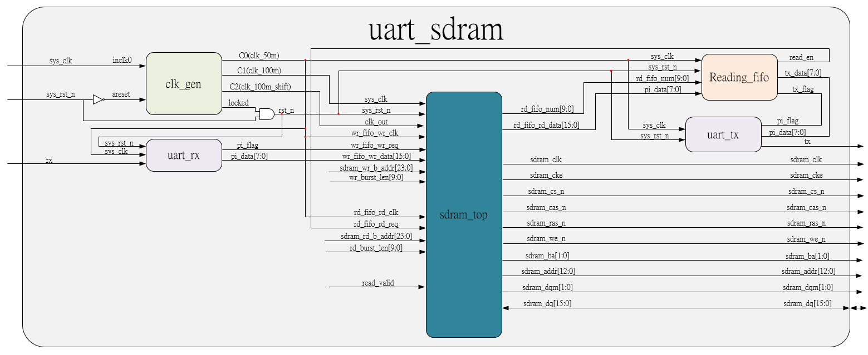
System

Slide 6
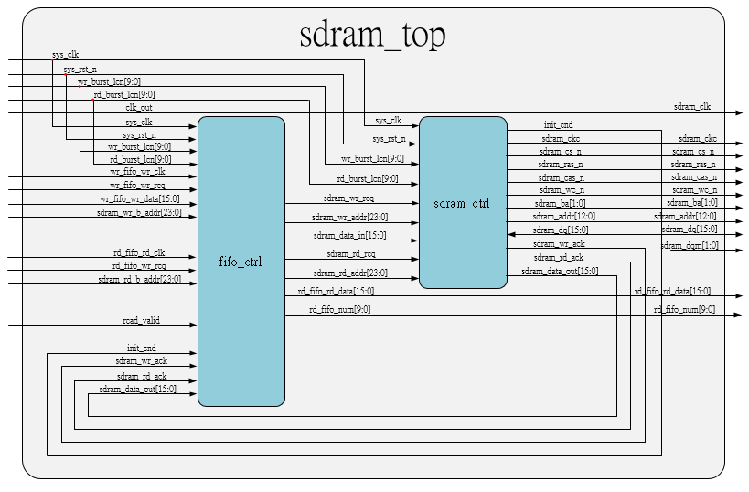
System_sdram_top

Slide 7
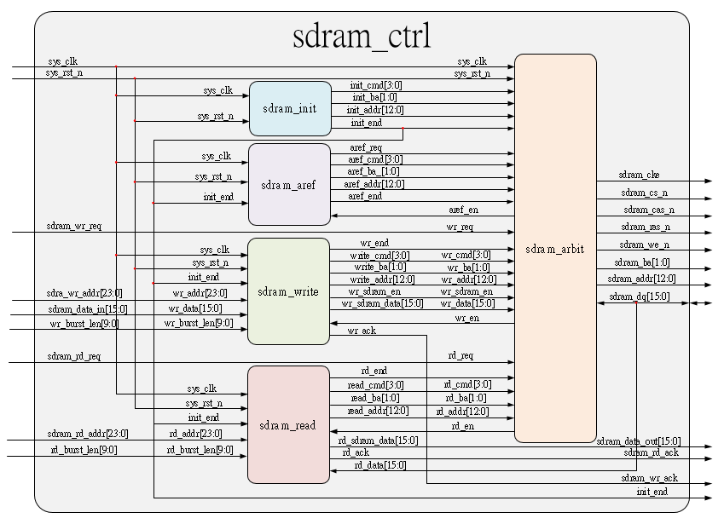
System_sdram_ctrl

Slide 8
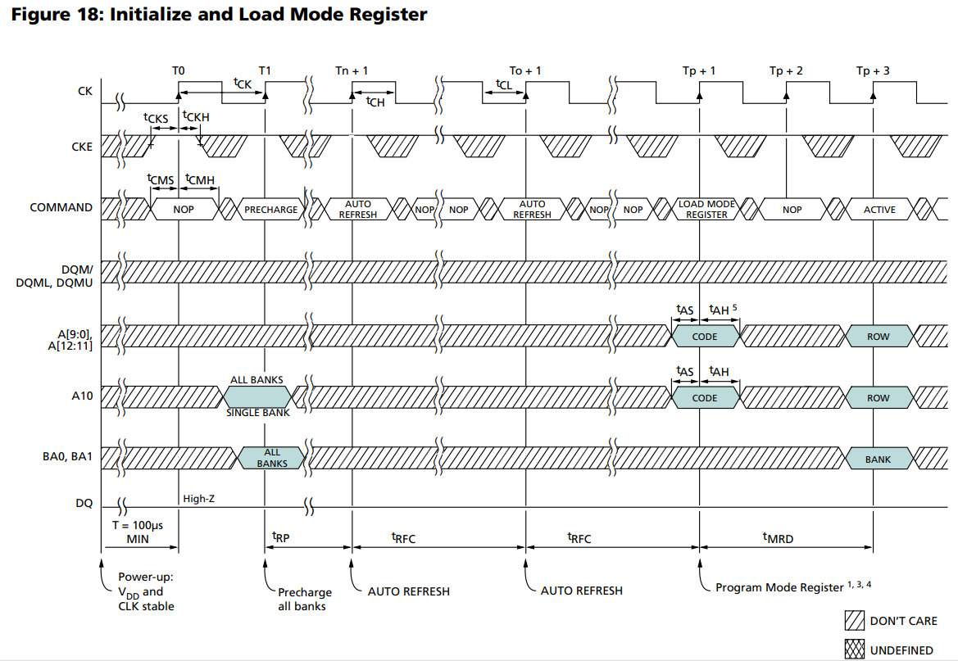
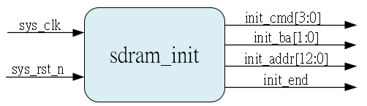
Sdram_init
If sdram power up, it needs initial first, and we should using LOAD MODE REGISTER command to setup the sdram mode.
Below is module diagram & operating timing diagram, command detail please refer to datasheet.
In this chapter, we want to set sdram mode as: 1. Burst length: full page
2. Burst type: sequential
3. CAS latency: 3 clocks.
4. Standard mode.
5. Write & read are burst.

Slide 9
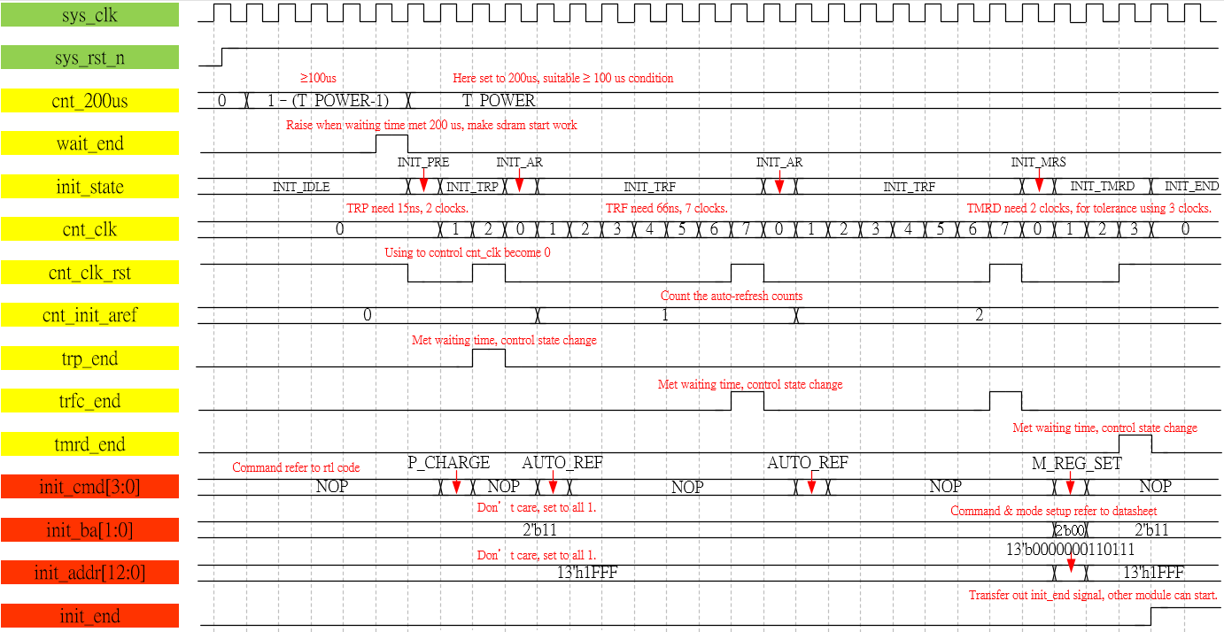
Waveform Graph - Sdram_init

Slide 10
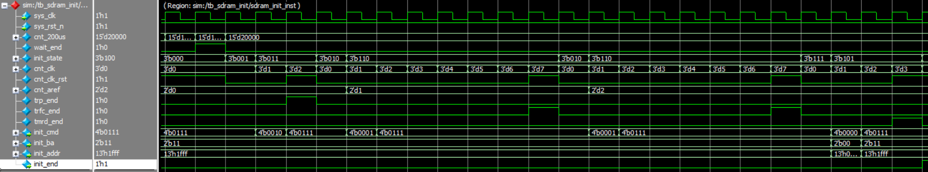
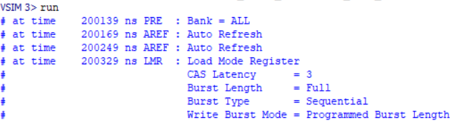
Simulation-sdram_init
In sdram, we also need to using test bench file to simulate, refer to sim code. The transcript shows auto refresh 2 time and Load mode register OK.

Slide 11
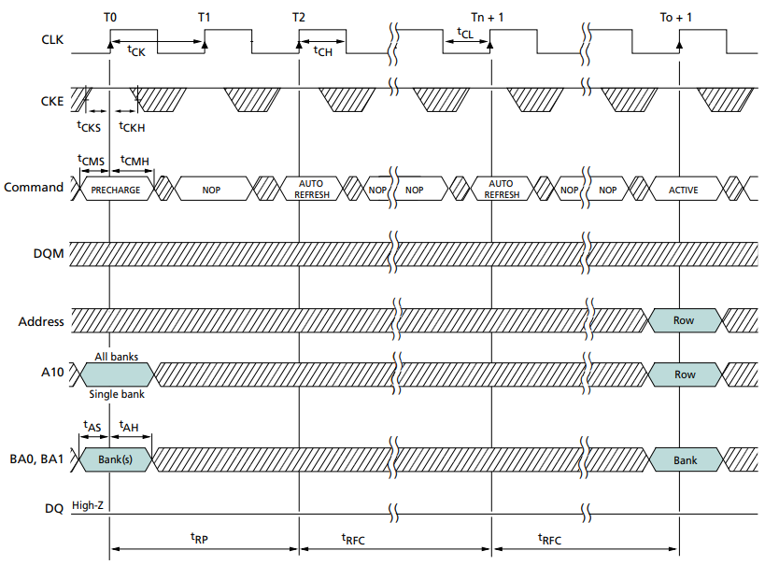
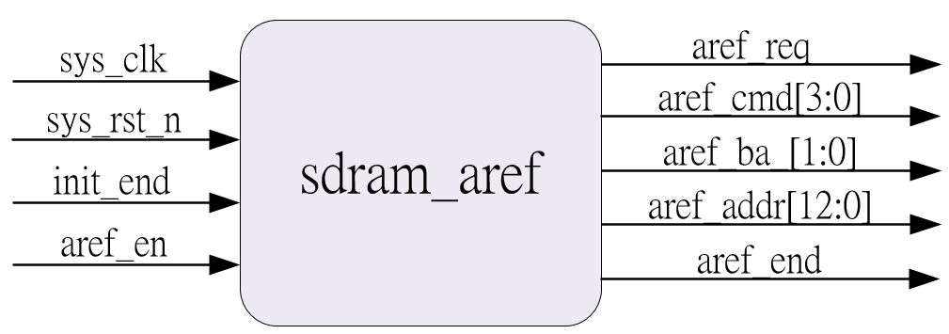
Sdram_auto_refresh
Sdram is using capacitance to store the high or low level data but it will decay by time, so it need to auto refresh to keep capacitance level is correct, refer to data sheet, we knows this sdram have 8192 rows, and refresh of each row interval is 64ms.
Auto refresh need to be execute 2 times, after auto refresh end, we can active the bank&row which want to be write or read.
In this module, we need to implement dotted line section.

Slide 12
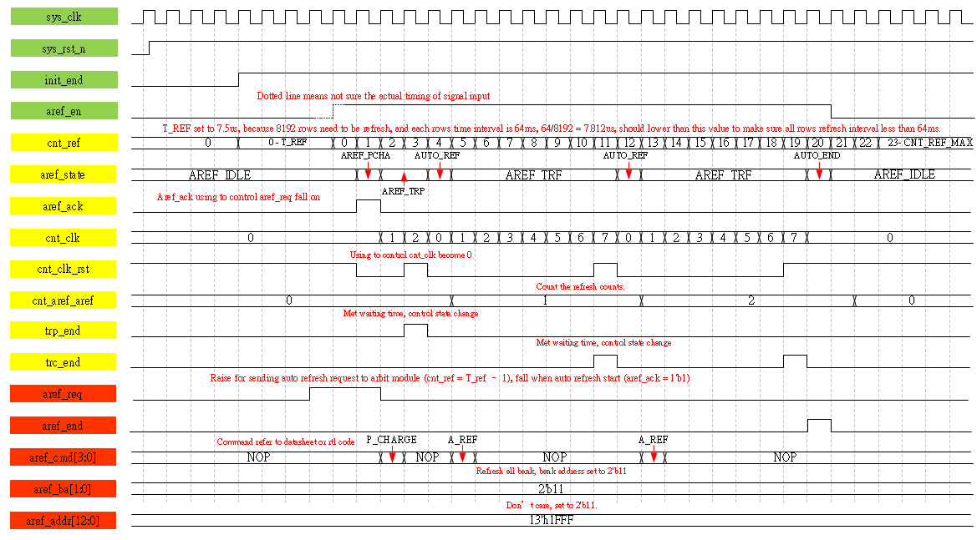
Waveform Graph - Sdram_aref

Slide 13
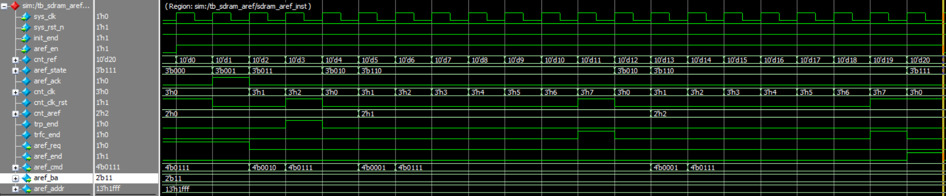
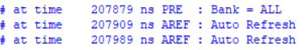
Simulation-sdram_aref
In sdram, we also need to using test bench file to simulate. The transcript shows auto refresh 2 time OK.

Slide 14
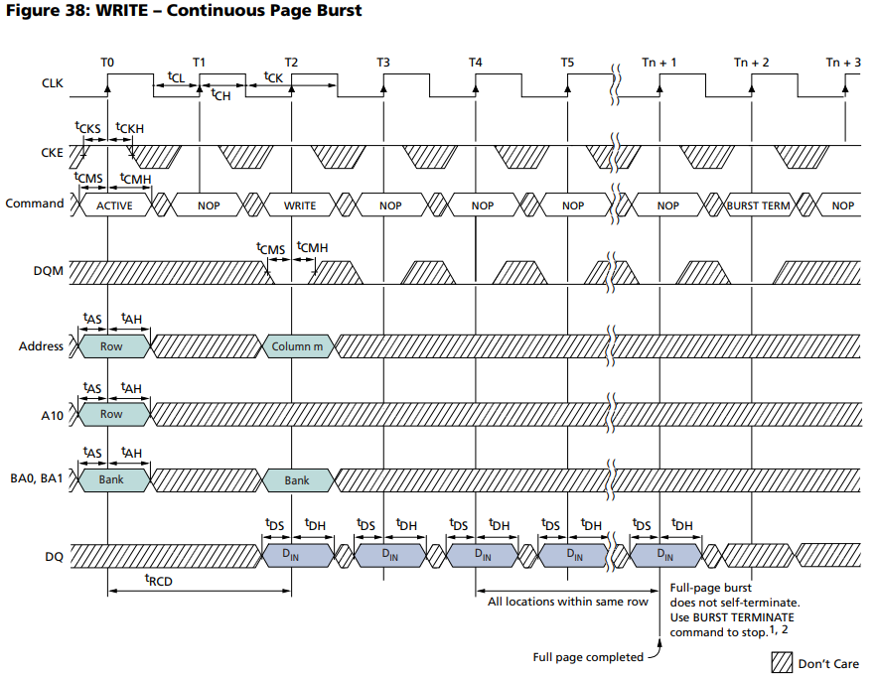
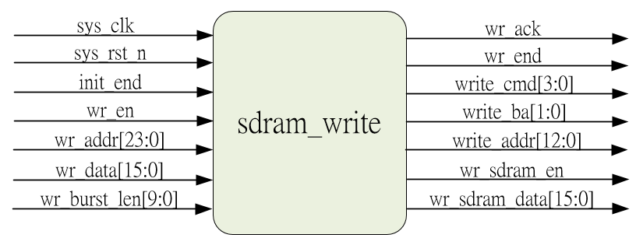
Sdram_write
In this chapter, we set sdram burst length is full page, so wee need to using burst terminate command to stop the write command, and our data & address is from fifo_ctrl module, so detail refer to waveform & rtl code.
Pre-charge
Due to full page write, so it wouldn’t start auto-pre-charge to deactivate the bank & row, so we need to doing pre-charge command in the end

Slide 15
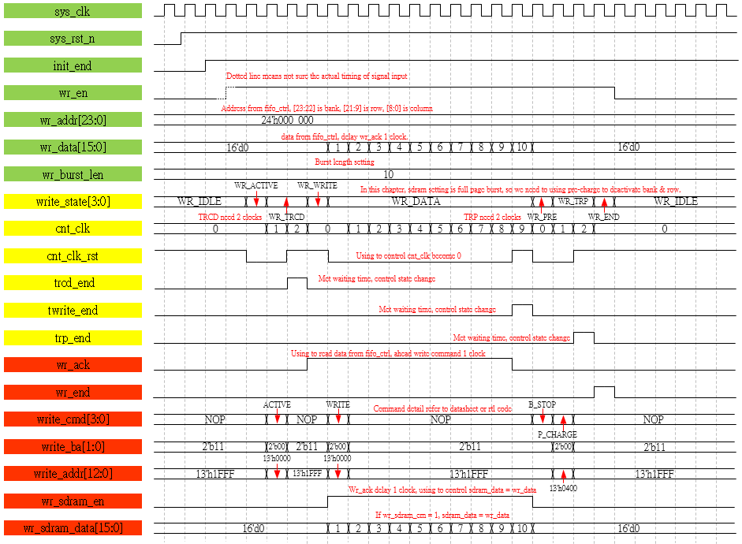
Waveform Graph - Sdram_write
High resolution picture refer to folder png file

Slide 16
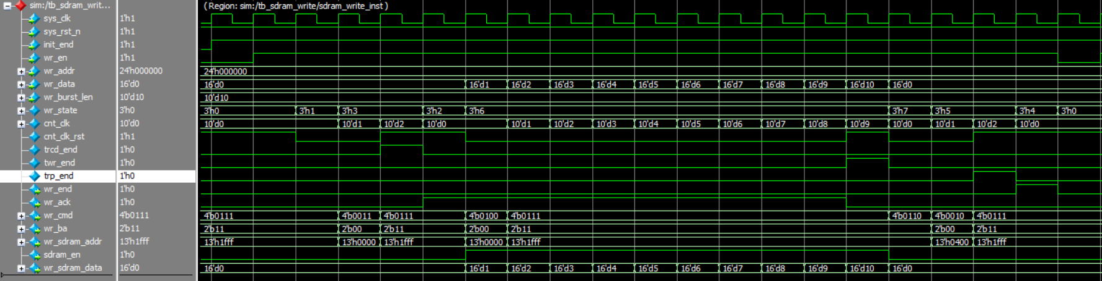
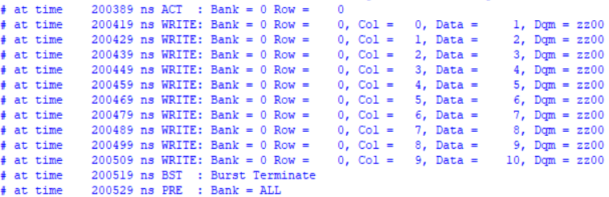
Simulation-sdram_write
In sdram, we also need to using test bench file to simulate. The transcript shows write 1 to 10, 10 data to sdram is OK.

Slide 17
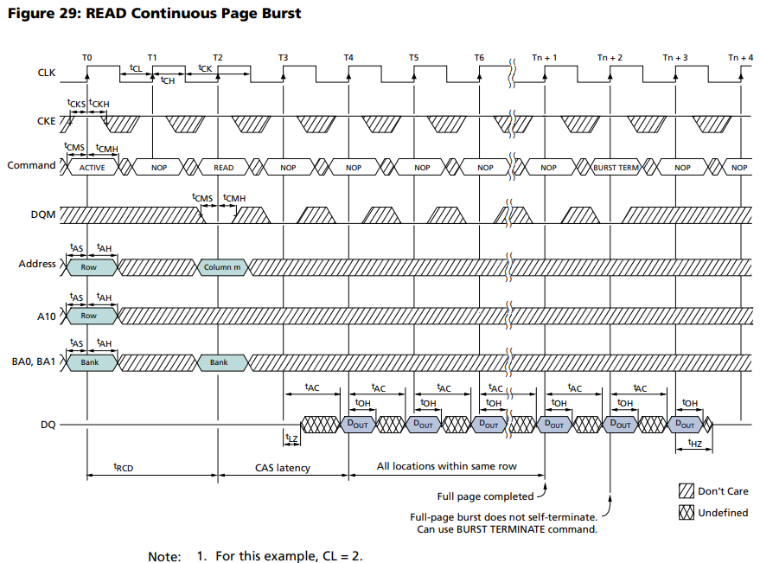
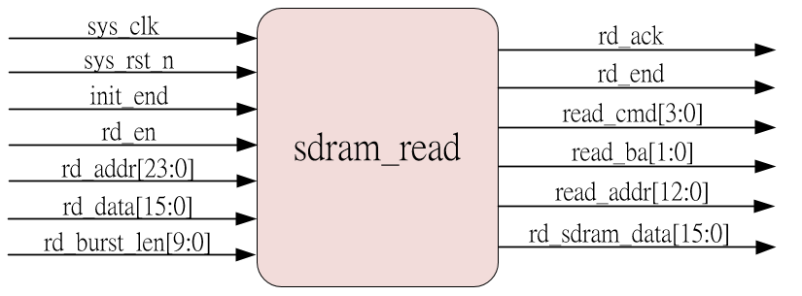
Sdram_read
In this chapter, we use the cas latency 3, and we want to read 10 data, so according timing, we need to execute terminate command after read command have been executed 10 clocks, and read from sdram data should be send to fifo_ctrl module, detail refer to waveform.
Pre-charge
Due to read, so it wouldn’t start auto-pre-charge to deactivate the bank & row, so we need to doing pre-charge command in the end

Slide 18
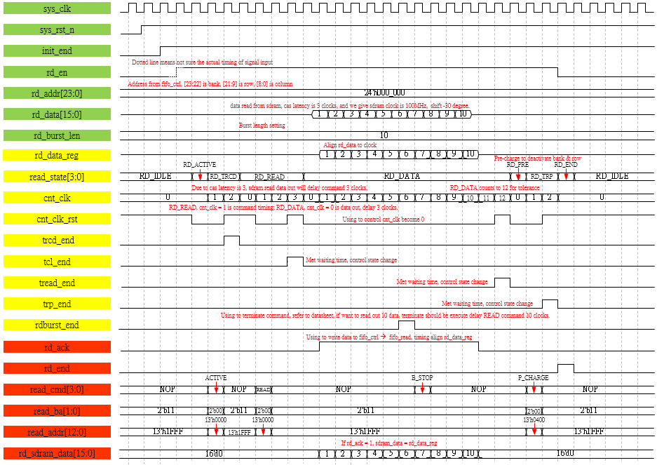
Waveform Graph - Sdram_read
High resolution picture refer to folder png file

Slide 19
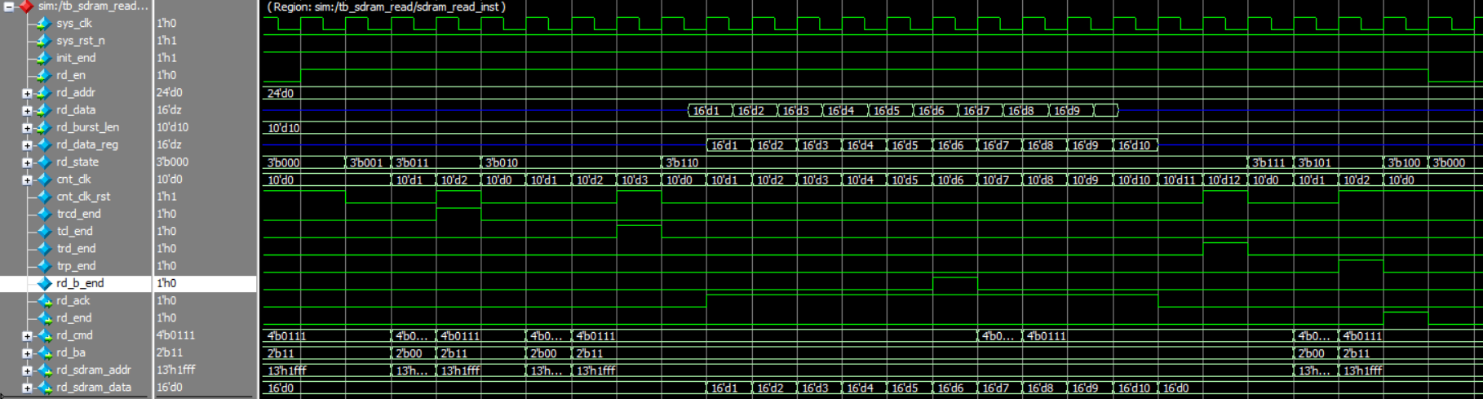
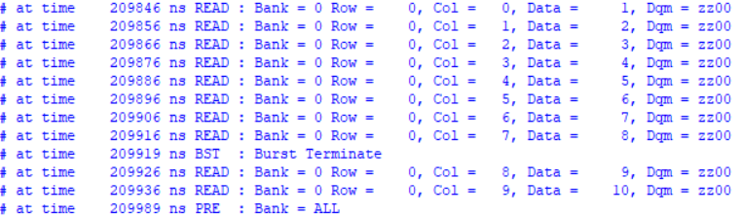
Simulation-sdram_read
In sdram, we also need to using test bench file to simulate. The transcript shows auto refresh 2 time OK.

Slide 20
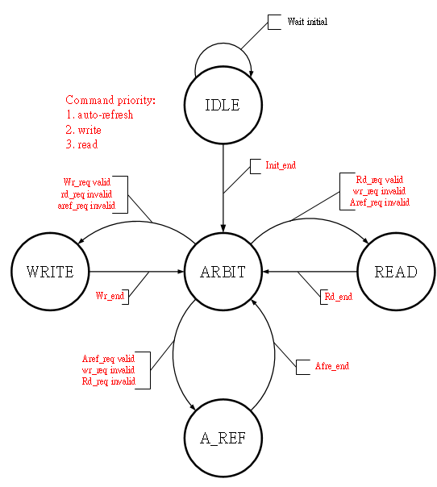
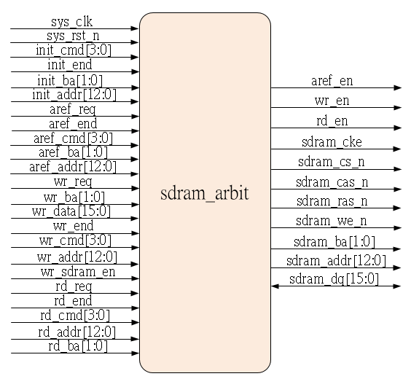
Sdram_arbit
In this chapter, we need to generate the sdram_arbit to judge the auto-refresh, write and read operation which should be execute at time, below is state about sdram_arbit module.
After initial, we should judge the which operation should be execute, and the command priority is auto-refresh > write > read.

Slide 21
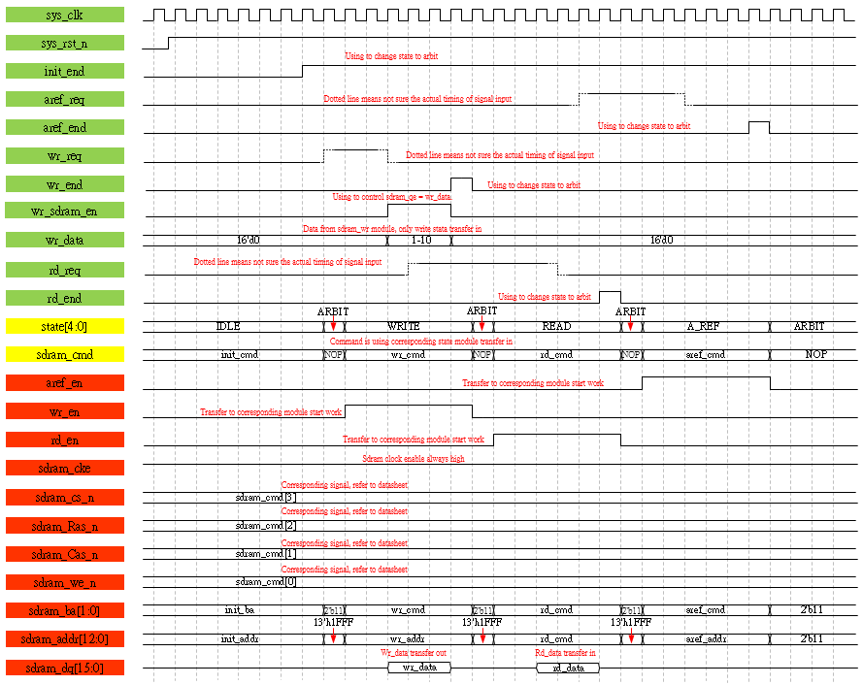
Waveform Graph - Sdram_arbit
High resolution picture refer to folder png file

Slide 22
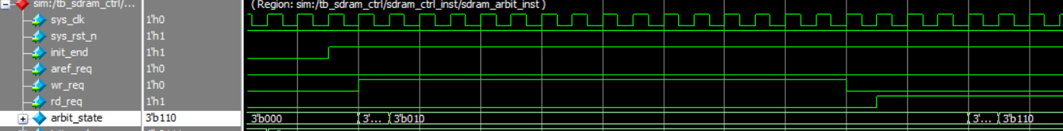
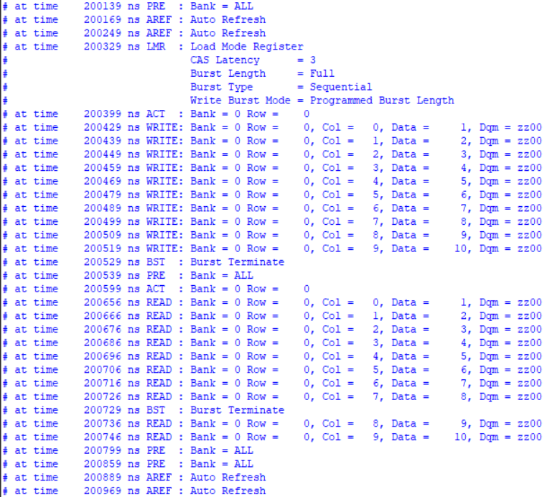
Simulation-sdram_ctrl_arbit
Due to arbit module variables are too much, so just check the state change is correct, and refer to transcript, arbit is match our testbench.

Slide 23
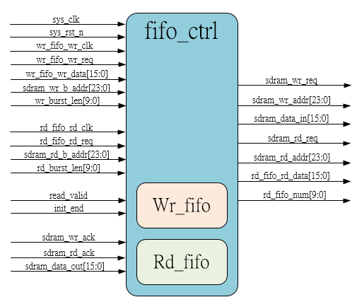
Sdram_fifo_ctrl
In this chapter, we need to generate the fifo_ctrl module to receive data from rx_module and store in wr_fifo then send wr_req & rd_req to sdram_arbit, write data to sdram and read data from sdram, read data will store in rd_fifo, final send data to reading_fifo.
Transfer data & pi_flag
Data written to wr_fifo
Rx
Fifo_ctrl
(wr_fifo)
Fifo_ctrl
Start sdram write (data from fifi_ctrl_wr_fifo)
Send wr_req to arbit
Send rd_req to arbit
Write complete
Fifo_ctrl
Sdram write
Sdram arbit
Start sdram read (data write to fifo_ctrl_rd_fifo)
Read complete
Sdram arbit
Sdram read
Fifo_ctrl (rd_fifo)
Data transfer out
Data transfer to reading fifo
Reading fifo
Inner fifo is asynchronous fifo, setting please refer to quartus project ip_core
Tx

Slide 24
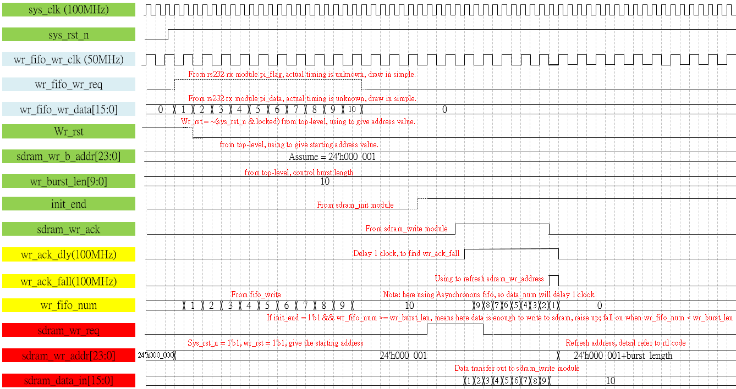
Waveform Graph – fifo_ctrl_wr_fifo

Slide 25
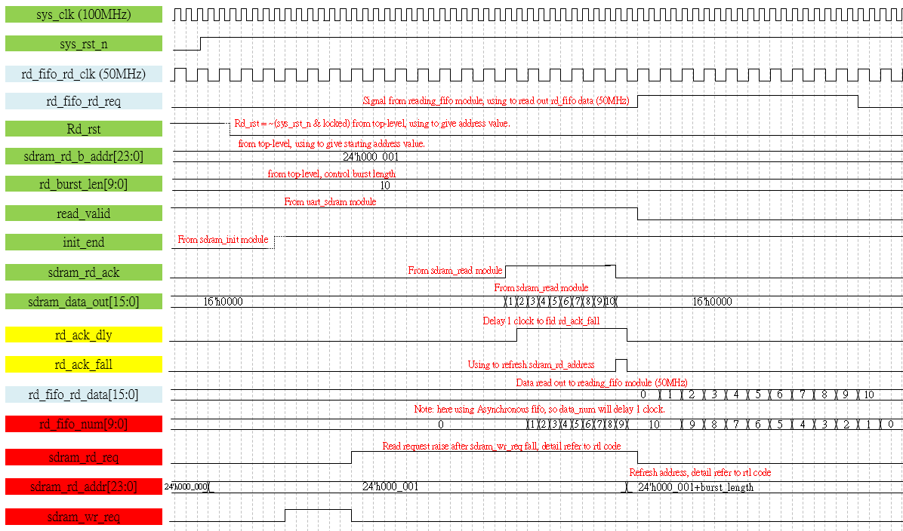
Waveform Graph – fifo_ctrl_rd_fifo

Slide 26
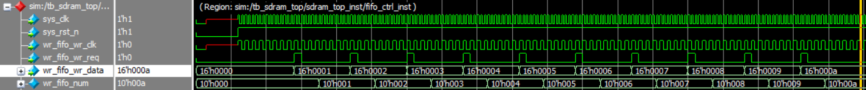
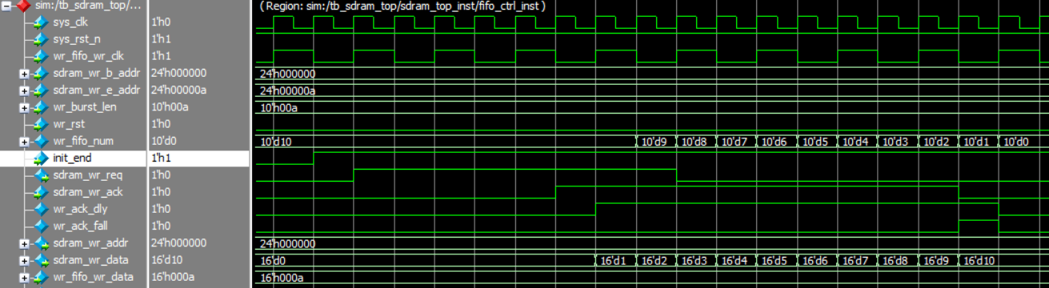
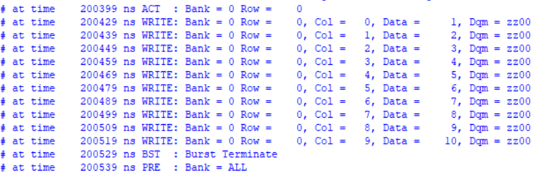
Simulation-fifo_ctrl_wr_fifo
Data have been written to wr_fifo
Sending sdram_wr_req after init_end & data_num >= 10, OK. And data transfer to sdram_write module is OK.

Slide 27
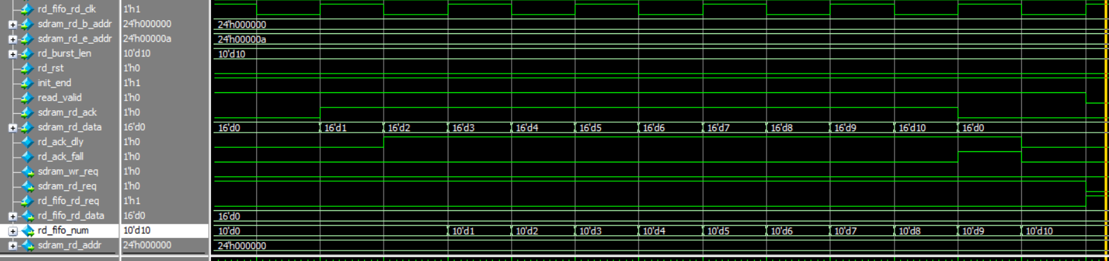
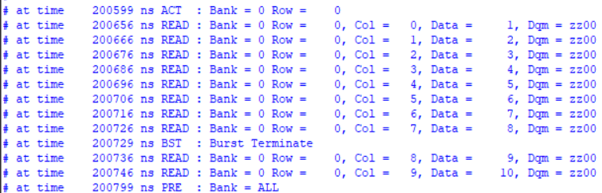
Simulation-fifo_ctrl_rd_fifo
Data have been written to rd_fifo
rd_fifo data have been transfer to reading_fifo

Slide 28
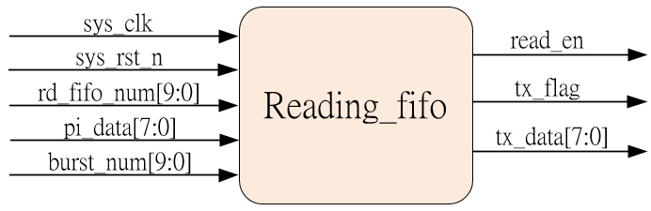
Sdram_reading_fifo
In this chapter, we need to generate the reading_fifo to read data from fifo_ctrl module, and transfer data & flag to tx module.
Transfer data & pi_flag
Data written to wr_fifo
Rx
Fifo_ctrl
(wr_fifo)
Fifo_ctrl
Start sdram write (data from fifi_ctrl_wr_fifo)
Send wr_req to arbit
Send rd_req to arbit
Write complete
Fifo_ctrl
Sdram write
Sdram arbit
This module using 50MHz clock, align tx module
Start sdram read (data write to fifo_ctrl_rd_fifo)
Read complete
Sdram arbit
Sdram read
Fifo_ctrl (rd_fifo)
Data transfer out
Data transfer to reading fifo
Reading fifo
Tx

Slide 29
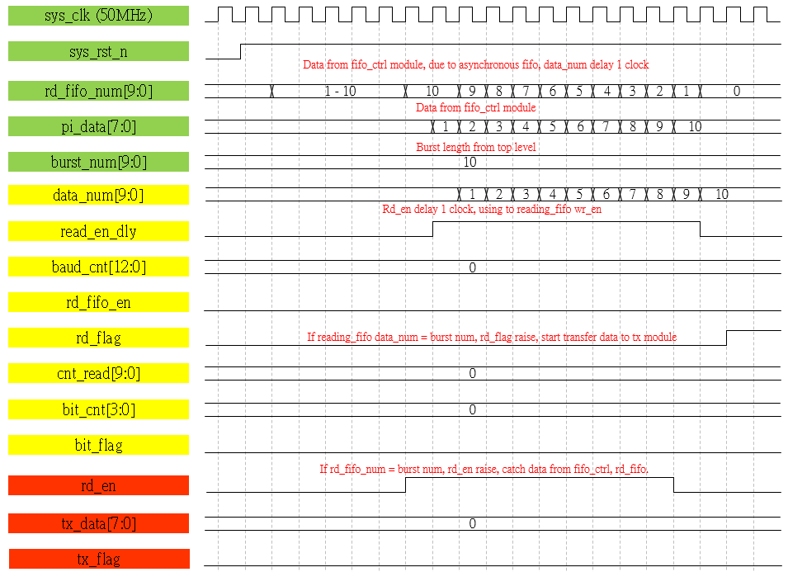
Waveform Graph – reading_fifo_write
Catch data from fifo_ctrl module

Slide 30
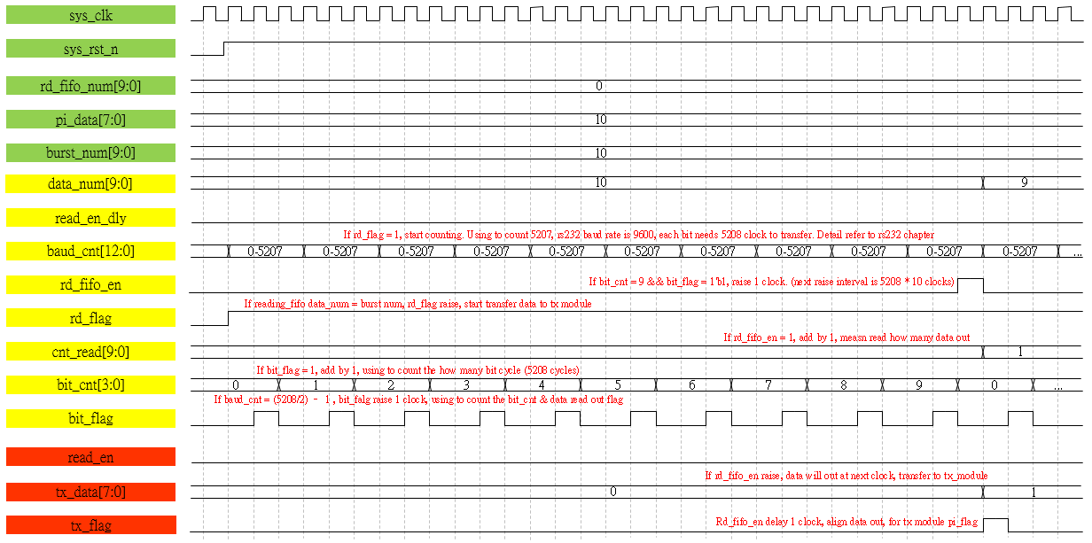
Waveform Graph – reading_fifo_read_1

Slide 31
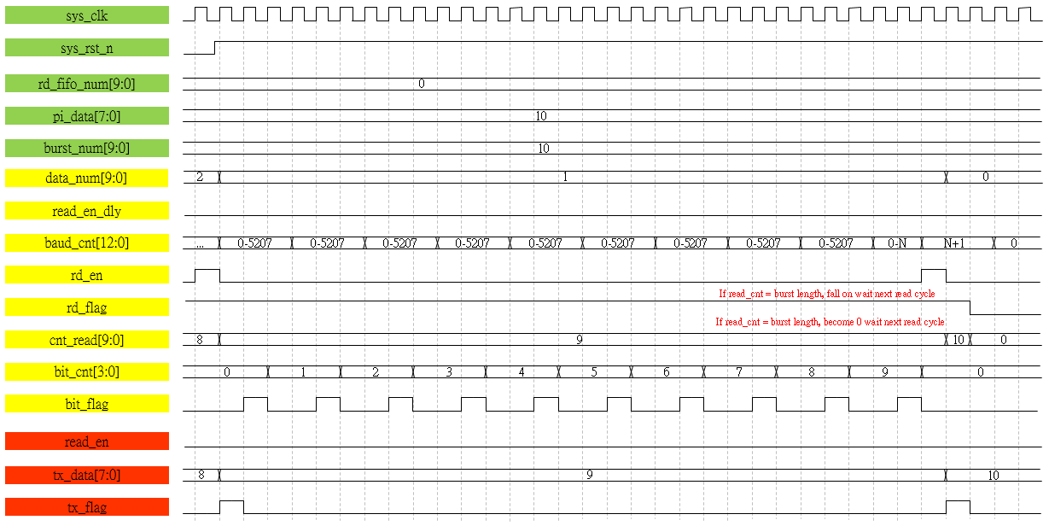
Waveform Graph – reading_fifo_read_2

Slide 32
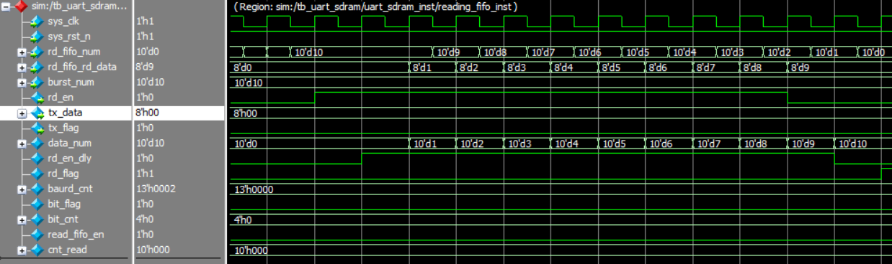
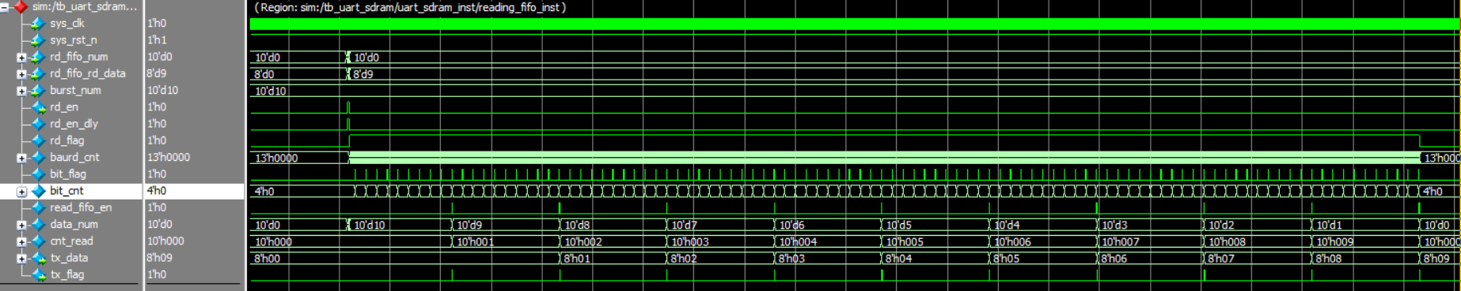
Simulation-reading_fifo
Data have been written to reading_fifo, data is 0 to 9, total 10 data.
Data transfer to tx module is OK.

Slide 33
Overall
All module have been simulated, so top module just connect all sub-module and the reading fifo is using uart_sdram top module to simulate, rx & tx module is using previous module, the function is OK.
If want to test the function in FPGA, download code to FPGA is OK, in this chapter we using quartus project, refer to quartus_prj folder.

